Slide 1
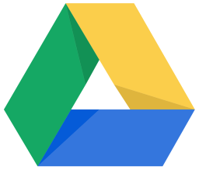
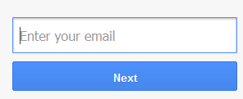
~ welcome to ~
Using the Cloud
with Google Drive
Before class begins, please write your name on the back of your Google Account slip. Then, sign in to your Google Account.
Open the Firefox web browser.
Click on the Google “Sign In” button.
Enter your username and password.
Remain on the Google Home screen.
Class Lesson Plans available at:
www.mc-npl.org/class-resources

Slide 2
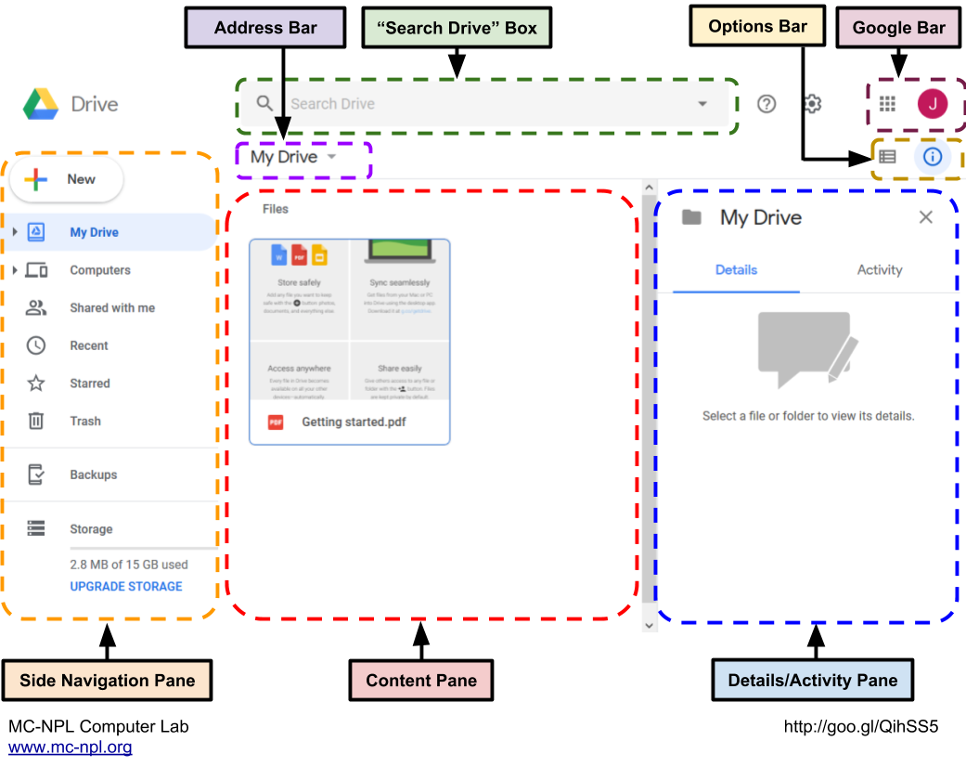
Google Drive

Slide 3
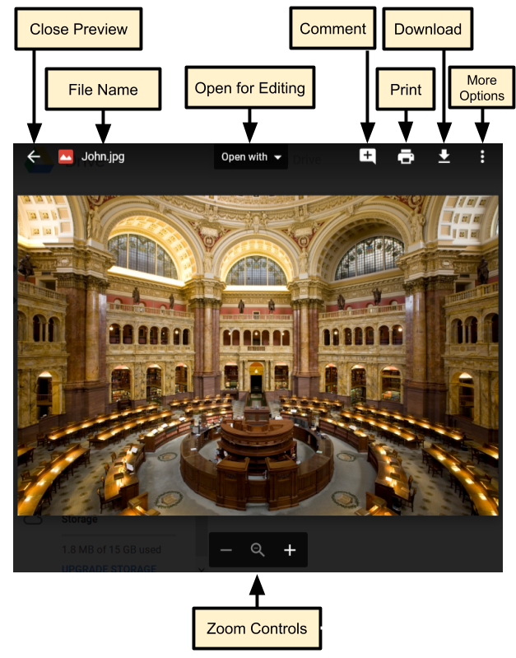
Preview Window

Slide 4
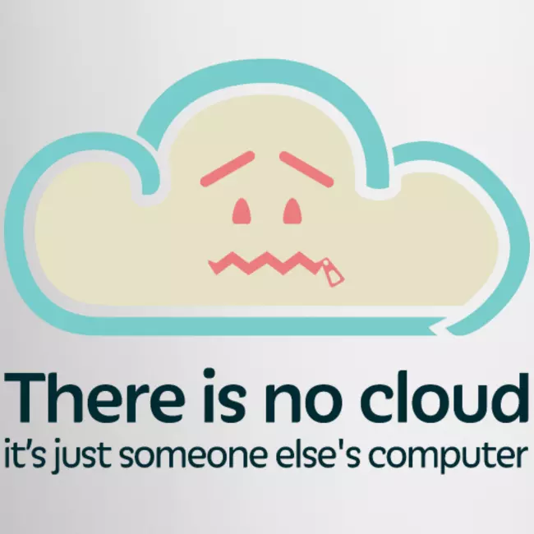

Slide 5
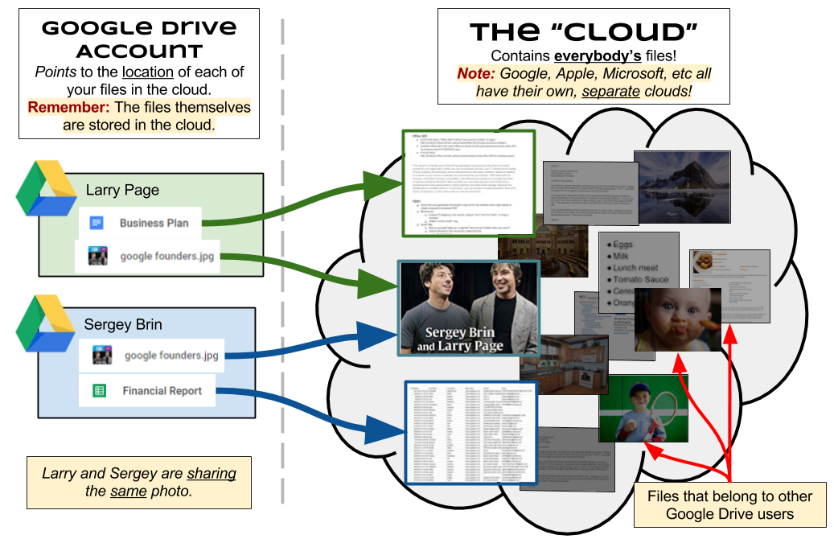
The Cloud: Demystified

Slide 6
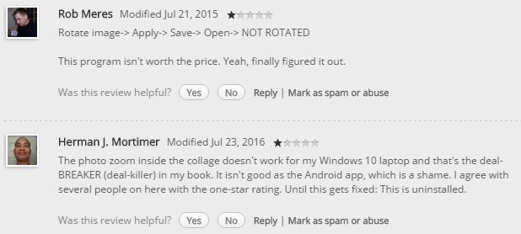
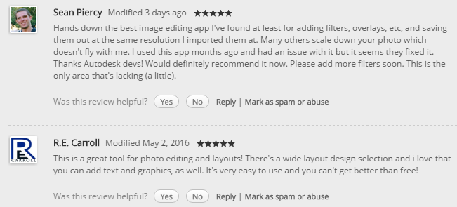
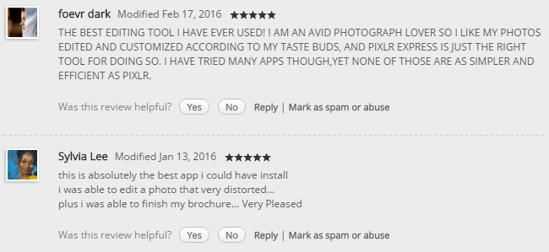
Reviews of a Good App

Slide 7
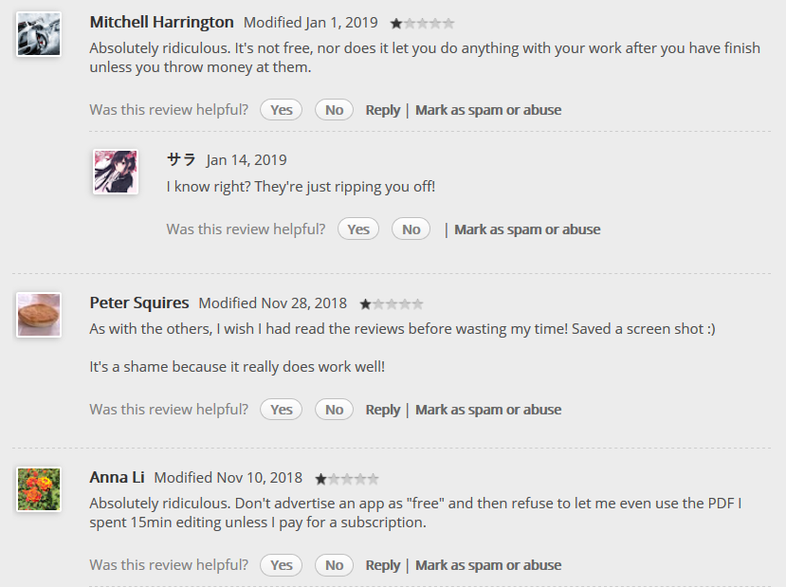
Reviews of a Bad App

Slide 8
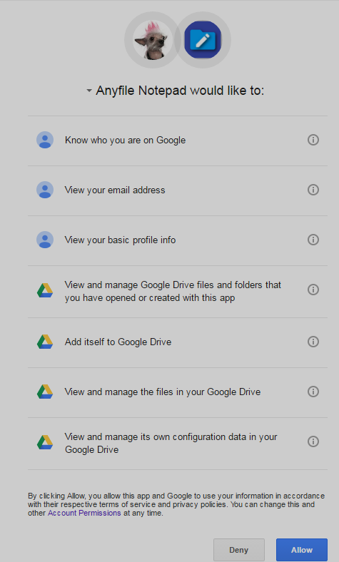
Excessive Permissions
Danger, Will Robinson!

Slide 9
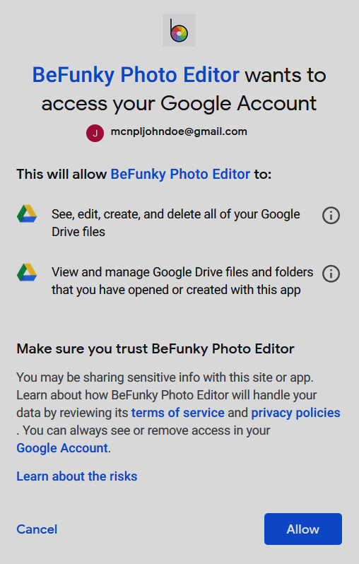
Excessive Permissions
Danger, Will Robinson!

Slide 10
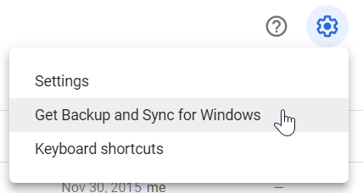
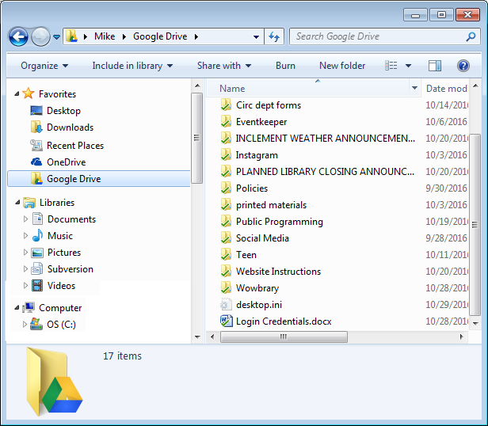
Backup and Sync

Slide 11
Storage Space
1 byte or 1 B | The smallest amount of measurable space.
1 kilobyte or 1 KB | 1,024 bytes (roughly 1,000 bytes)
1 megabyte or 1 MB | 1,024 kilobytes (roughly 1,000 kilobytes)
1 gigabyte or 1 GB | 1,024 megabytes (roughly 1,000 megabytes) Google Drive gives you 15 GB
1 terabyte or 1 TB | 1,024 gigabytes (roughly 1,000 gigabytes)

Slide 12
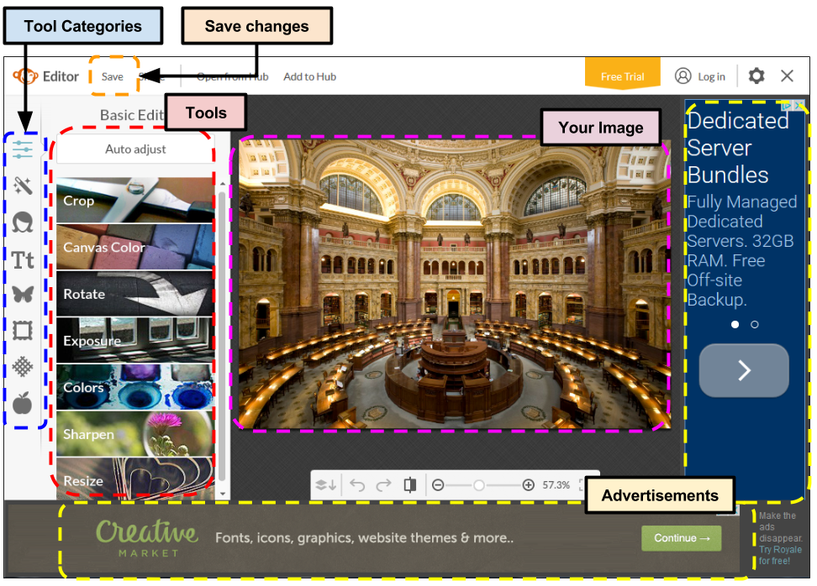
PicMonkey Screen

