Slide 1
Shelbyfield Animal Rescue
Featured Adoptable Pets

Slide 2
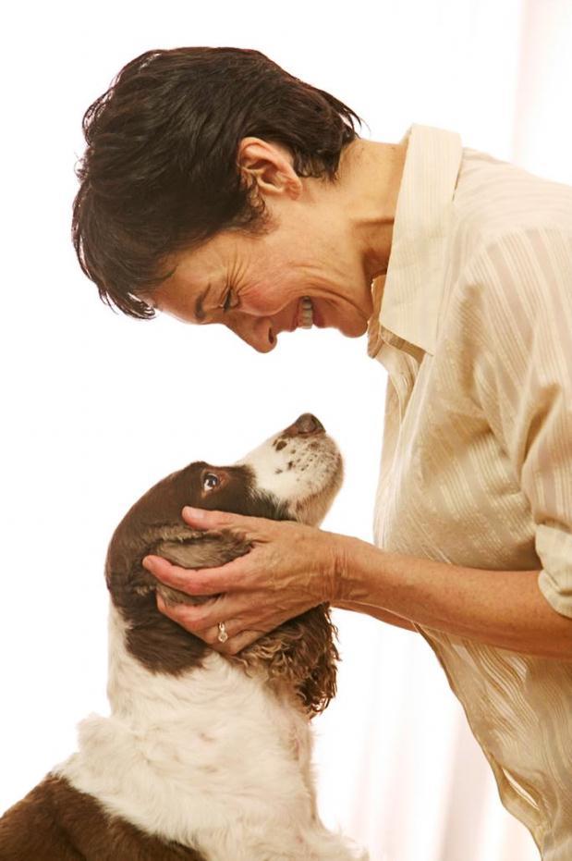
Mission
Founder Aurelia Cerda
and her faithful friend, Coco
…to rescue, rehabilitate, and re-home stray or unwanted pets. We are dedicated to helping animals in need, and helping you find the perfect pet for your home.

Slide 3
Man’s Best Friend
Adoptable Dogs

Slide 4
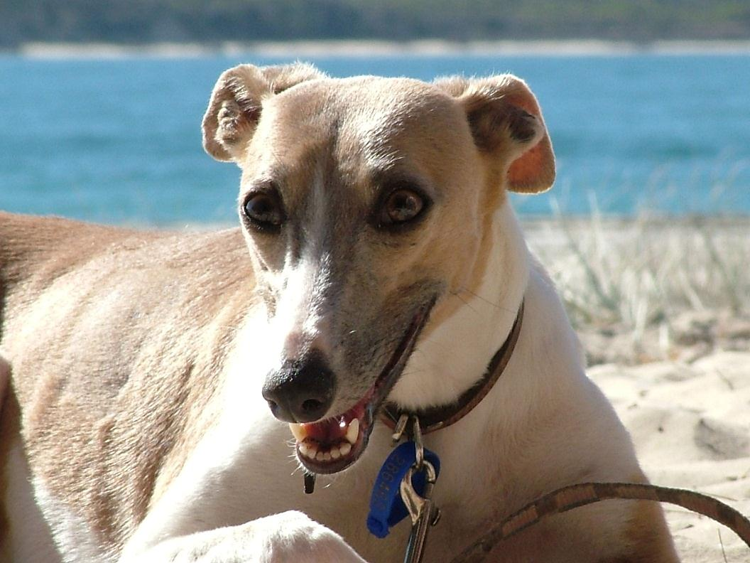
Franny
Female 30 lbs.
Whippet 5 years old
Likes: Long walks on the beach
Dislikes: Drama

Slide 5
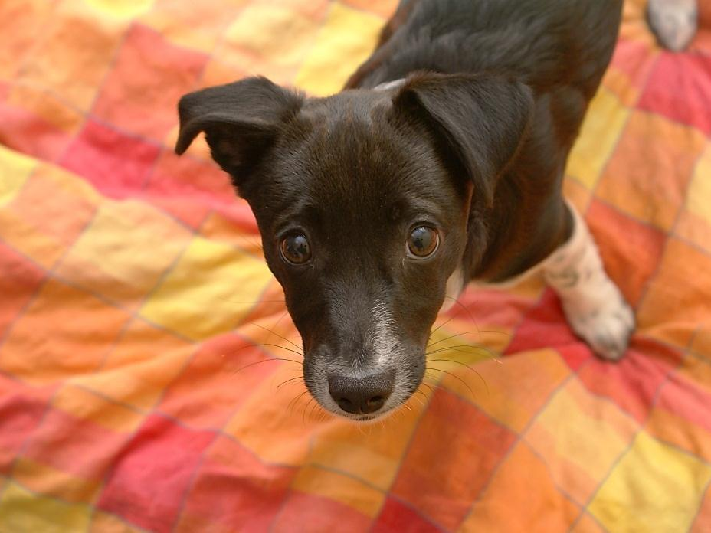
Zooey
Male 18 lbs.
Border Collie Mix 3 months old
Likes: Cookies
Dislikes: Fruits and vegetables

Slide 6
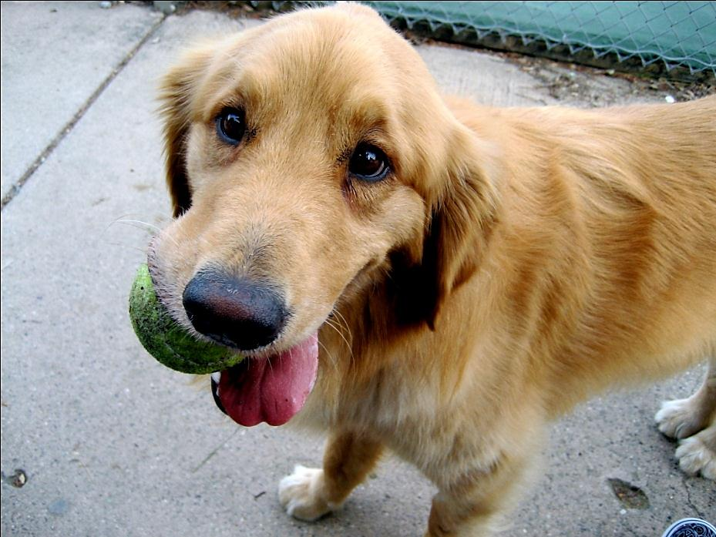
Salinger
Male 72 lbs.
Golden Retriever 3 years old
Likes: Filthy tennis balls
Dislikes: Clean tennis balls

Slide 7
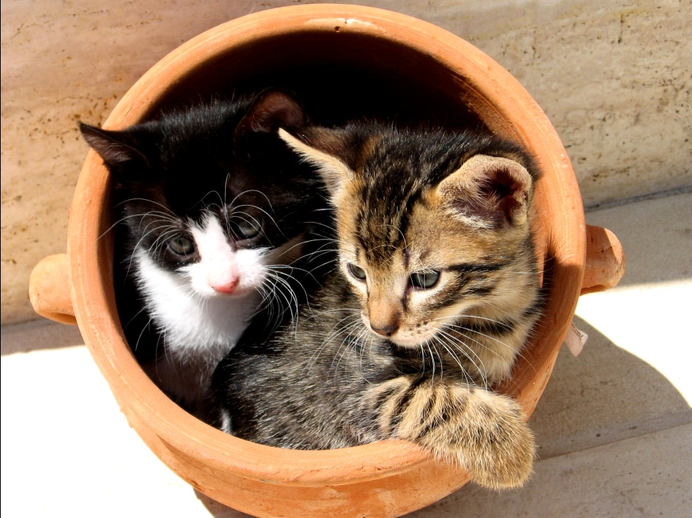
Khan & Bagheera
Male & Female 7 & 5 lbs.
Shorthair Cats 6 months old
Likes: Clay pots
Dislikes: Pans

Slide 8
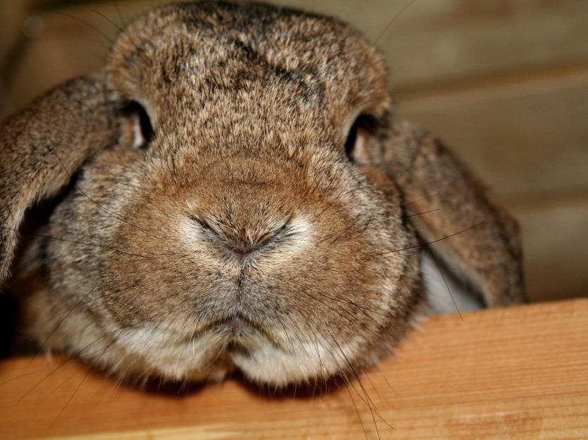
Beatrix
Female 10 lbs.
French Lop 2 years old
Likes: Running
Dislikes: Losing to the tortoise

Slide 9
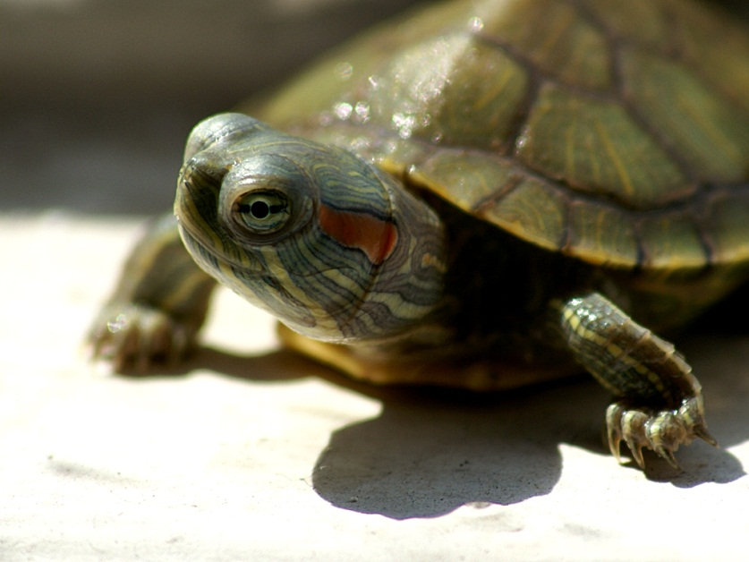
Donatello
Male 4 lbs.
Red-Eared Slider 1 year old
Likes: Pizza
Dislikes: Foot soldiers

